Slide 1
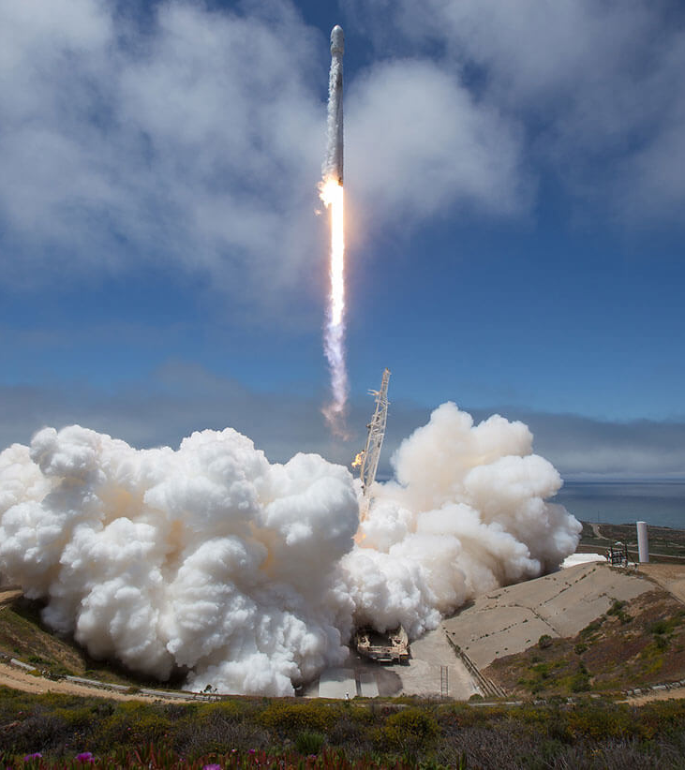
IBM Data Science Capstone
Rocket Launch Data
Jon Luke Chartier
2/19/2025

Slide 2
Outline
Executive Summary
Introduction
Methodology
Results
Conclusion
Appendix

Slide 3
Executive Summary
In order to gain insight into the data, we used:
Data Collection via REST APIs and Web Scraping
Exploratory Data Analysis (EDA)
Data Visualization
Data Wrangling
Predictive Analysis
The findings:
A
B
Over time, SpaceX has been more successful and consistent in retrieving the first-stage booster.

Slide 4
Introduction
Our goal was to predict when and why Falcon 9 first-stage boosters are recovered and reused. This meant using Exploratory Data Analysis to discover insights into booster recovery as well as developing a classification model to predict future booster reuse.
The primary questions are:
What factors contribute most to booster recovery?
What factors go into successful booster recovery vs. failure?
How have booster recovery rates changed over time?

Slide 5
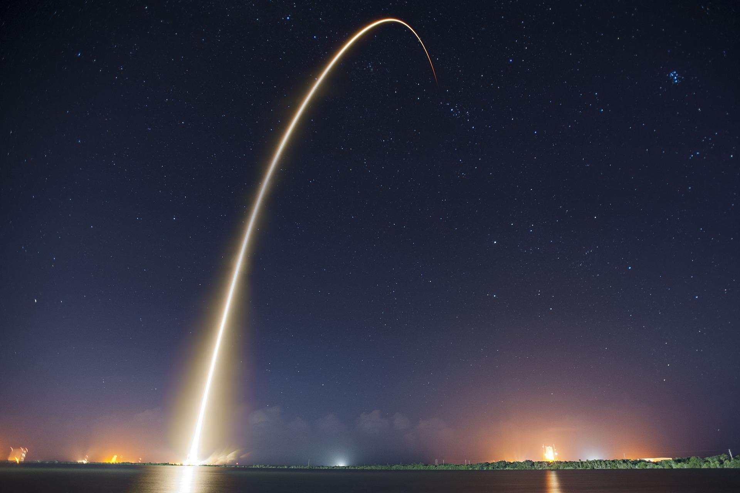
Section 1
Collection, Analysis, Visualization, and Prediction

Slide 6
Overview
Executive Summary:
Data Collection Methodology
Collected via SpaceX API and webscraping.
Data Wrangling
Data was preprocessed by replacing Null values with mean column value as well as encoding the target column, Outcome.
Exploratory Data Analysis via SQL
Interactive Analytics via Folium and Plotly Dash
Predictive Analysis and Classification Model

Slide 7
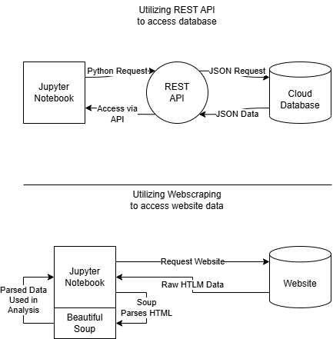
Data Collection
Two data collection methods were used:
REST API
Webscraping
Using the REST API, the Notebook makes a request to the API. The API then accesses the database via a JSON request, and the database returns the requested data in JSON. The API then passes the requested data, still in JSON format, to the Notebook.
Utilizing Webscraping, the Notebook requests the raw HTLM from the page. Then, within the Notebook, Beautiful Soup parses the HTLM, allowing the underlying to be used in analysis.

Slide 8
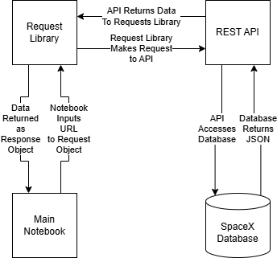
Data Collection – SpaceX API
In order to access the data via API, we used the Python Requests library to query SpaceX’s REST API. The API then returned the requested data in JSON format as a part of the Response object. In between, the API retrieved the requested information from the SpaceX Database.
Github Link: https://github.com/JC18000/IBM-Data-Science-Capstone/blob/43d78063af2f5758999725e170d15c4e987584da/jupyter-labs-spacex-data-collection-api.ipynb

Slide 9
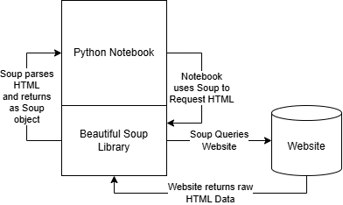
Data Collection – Webscraping
With Webscraping, we utilized the table within a Wikipedia article. The Notebook utilizes the Beautiful Soup Library, which queries the website, parses the raw HTML data, and gives us a Soup object. We then found the data within the Wikipedia table by manipulating the soup to find table columns and data.
Github Link: https://github.com/JC18000/IBM-Data-Science-Capstone/blob/43d78063af2f5758999725e170d15c4e987584da/jupyter-labs-webscraping.ipynb

Slide 10
Data Wrangling and Initial EDA
Summarize what charts were plotted and why you used those charts
Add the GitHub URL of your completed EDA with data visualization notebook, as an external reference and peer-review purpose
EDA:
Launch site occurrence
CAFS: 55
KSC: 22
VAFB: 13
Orbit type occurrence
GTO: 27
ISS: 21
VLEO: 14
Other: 28
Mission outcome occurrence
Success: 65
Failure: 25
Wrangling:
Main Wrangling was encoding Outcome column to be either 1 (booster was retrieved) or 0 (booster was lost)
Encoding was as follows:
True ASDS: 1 (41 instances)
True RTLS: 1 (14 instances)
True Ocean: 1 (5 instances)
None None: 0 (19 instances)
False ASDS: 0 (6 instances)
False Ocean: 0 (2 instances)
False RTLS: 0 (1 instance)
Github Link: https://github.com/JC18000/IBM-Data-Science-Capstone/blob/065d066bab59aa48775e75cdcb99ab517943acb9/labs-jupyter-spacex-Data%20wrangling.ipynb
Reference:
“True” means the booster was successfully recovered, “False” means it was not. ASDS means Drone Ship, while RTLS means Ground Pad. “Ocean” means the booster was purposefully landed in the ocean and fished out.

Slide 11
Exploratory Data Analysis with SQL
SQL Queries Performed:
Unique launch sites
5 records beginning with ‘CCA’
Total payload mass carried for NASA
Average payload mass carried by F9 v1.1
Date of first successful ground pad landing
Drone ship landing of boosters carrying 4000-6000kg
Number of successful and failure outcomes
Booster versions carrying maximum payload
Months, booster, site, and outcome in 2015
Rank landing outcomes from 2010-06-04 to 2017-03-20 by frequency
Github Link: https://github.com/JC18000/IBM-Data-Science-Capstone/blob/886a4bd16115f5cab3c38b9430f9e87ed79be78f/jupyter-labs-eda-sql-coursera_sqllite.ipynb

Slide 12
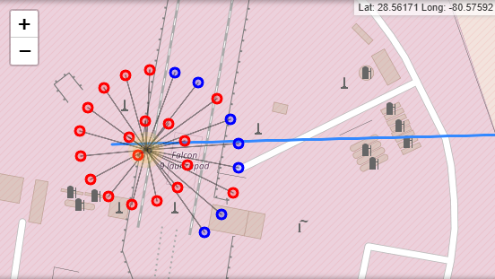
Building an Interactive Folium Map
The interactive map includes clustered points, which can be expanded to show the number of successes (blue) and failures (red) resulting from each launch pad.
The blue line included maps the distance from the launchpad to the nearest coastline, at about one kilometer.
These features allow the user to easily see the distribution of launches visually, rather than from numbers alone. The interior of the spiral represents the first launches, while the exterior tail represents the last launches, also giving the user a solid understanding of how the success and fail frequencies changed over time.
Github Link: https://github.com/JC18000/IBM-Data-Science-Capstone/blob/886a4bd16115f5cab3c38b9430f9e87ed79be78f/jupyter-labs-eda-sql-coursera_sqllite.ipynb

Slide 13
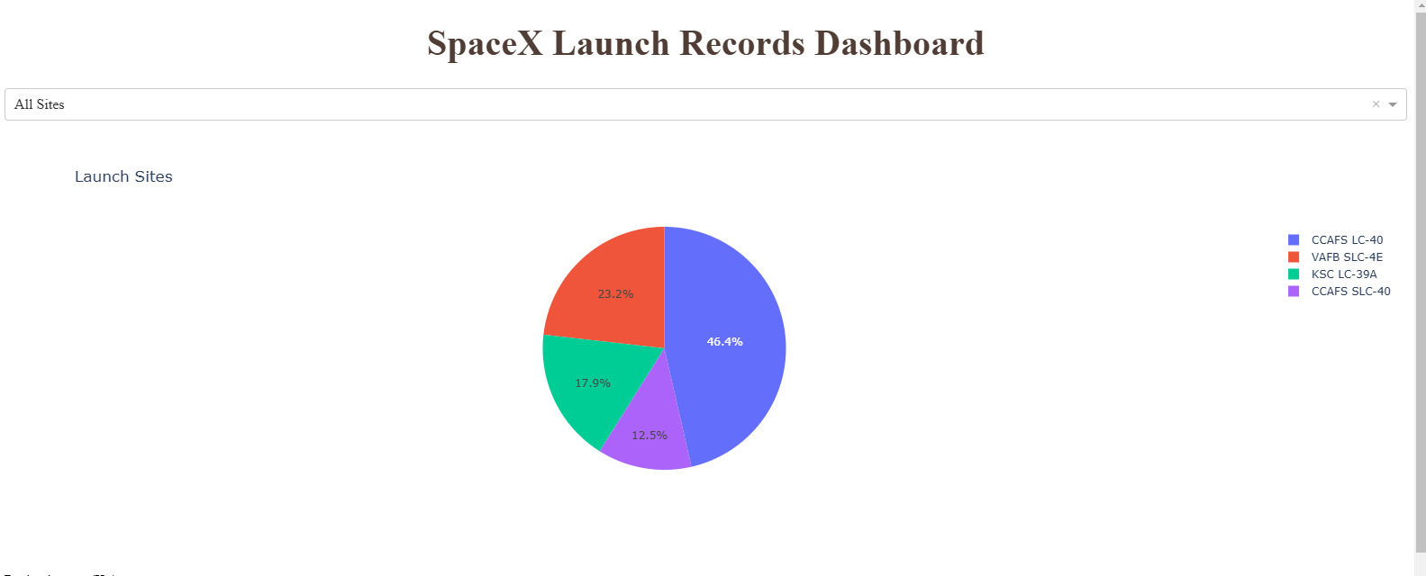
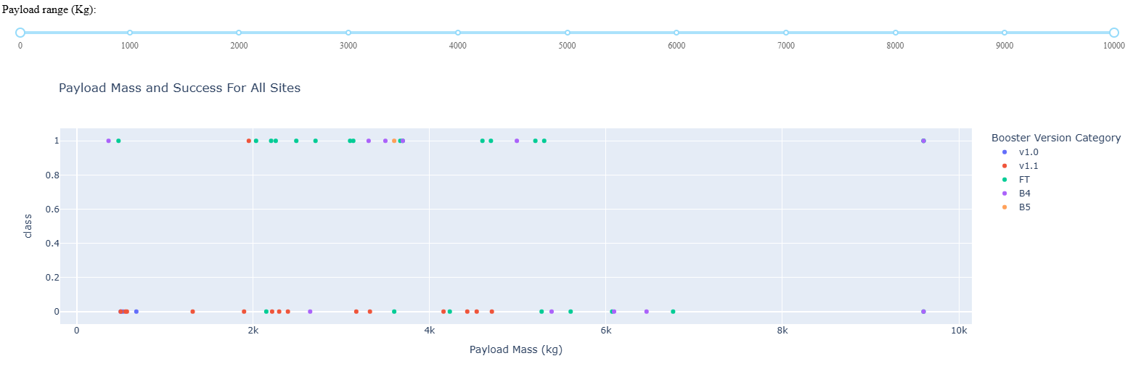
Building a Dashboard with Plotly Dash
Two graphs were made, a pie chart for showing proportions and a scatter plot for showing the relationship between payload mass and booster version. The pie chart came with a dropdown that allowed the user to see a pie chart for either the proportion of every launch site, or the proportion of successes and failures for a single specified launch site. The scatter plot also came with a slider that allowed the user to specify the range of payload masses viewed.
Github Link: https://github.com/JC18000/IBM-Data-Science-Capstone/blob/871cfe666f542c1d7f204c6c3ea5661f971b2247/spacex_dash_app.py

Slide 14
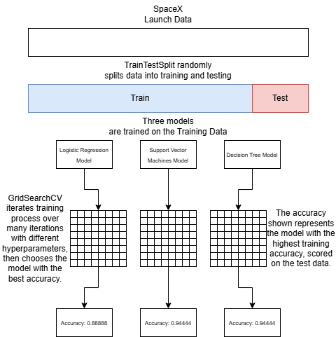
Predictive Analysis
In order to determine the best model to be used, a GridSearchCV was used to find the optimal hyperparameters over four models: Logistic Regression, Support Vector Machines, Decision Tree, and KNN. In the end, the Support Vector Machine model had the best performance.
Github Link: https://github.com/JC18000/IBM-Data-Science-Capstone/blob/871cfe666f542c1d7f204c6c3ea5661f971b2247/SpaceX_Machine%20Learning%20Prediction_Part_5.ipynb

Slide 15
Results
What was discovered from EDA:
The rate of success went up over time
The CCAFS LC-40 was the most used, and the CCAFS CLC-40 was the least used pad
The highest payload to be launched was between 9-10 thousand kilograms
c
Results of predictive analysis:
The development of an accurate model in order to classify whether a given mission will have its first-stage booster recovered based on the launchpad, payload mass, booster type, and more.

Slide 16
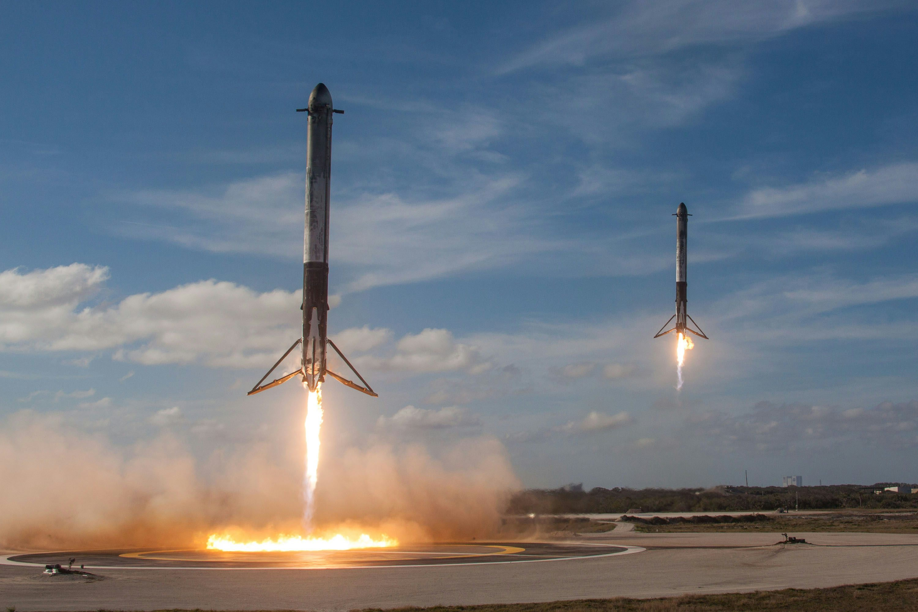
Section 2
Visualizing Data,
Gaining Insights

Slide 17
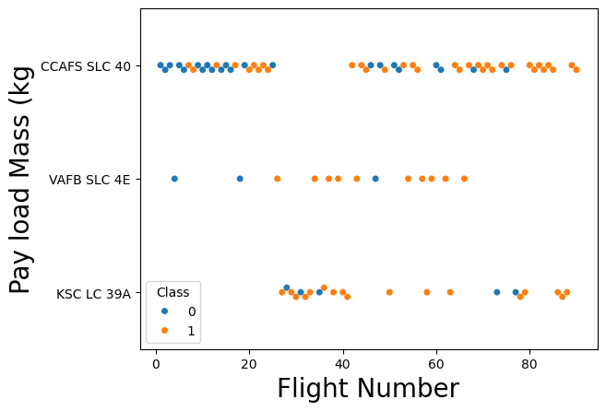
Flight Number vs. Launch Site
This plot shows that the CCAFS SLC-40 launch site was used the most. When the KSC launch site was first introduced, it had prevalence over the CCAFS site, before its use became sporadic. The VAFB launch site was rarely used, and ultimately was phased out of use.

Slide 18
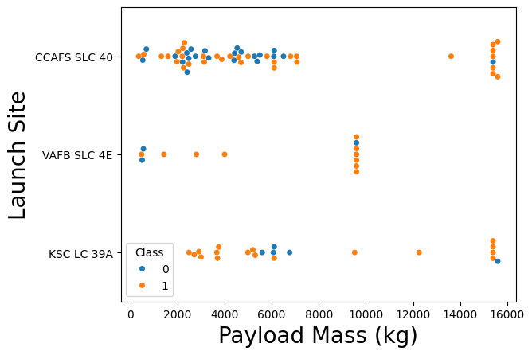
Payload vs. Launch Site
This plot shows that at low masses, there is great variation. At higher masses, there tends to be strong clustering, where several launches use the exact same or similar payload. We can see that the VAFB launch site was primarily used for mid-weight launches with some low weight ones. The CCAFS site was used for many low-weight launches, as well as many of the high-weight ones. The KSC site also supported some high-weight launches, as well as several low-weight launches.

Slide 19
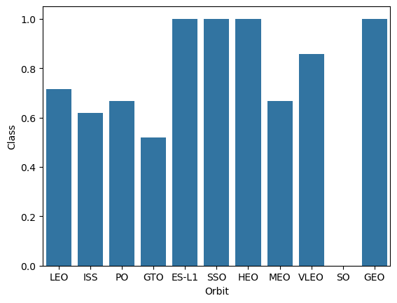
Success Rate vs. Orbit Type
This plot shows that the most successful launches involved the ES-L1, SSO, HEO, and GEO orbits. We can also tell that SO orbit launches have had 0 successful launches.

Slide 20
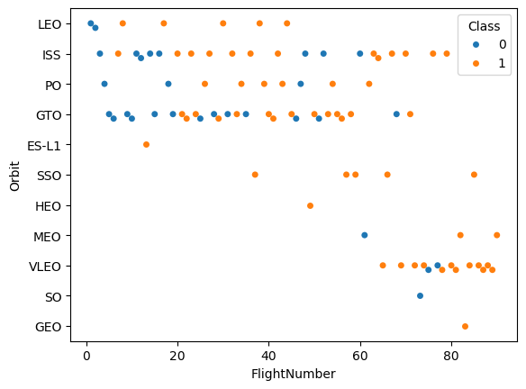
Flight Number vs. Orbit Type
This plot shows the evolution of orbit use over time. We can see that the most common ones in the beginning were ISS and GTO. However, after launch 60, VLEO became available, and quickly became the most popular orbit type. ISS orbits were still important in this period.

Slide 21
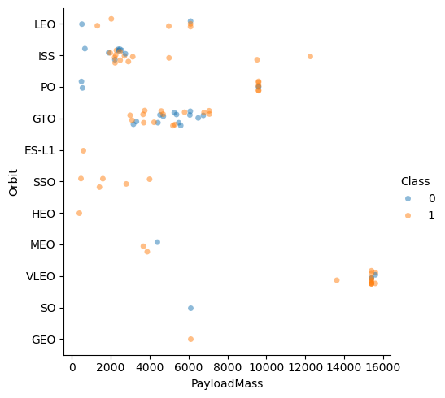
Payload vs. Orbit Type
This plot shows the variations in payload mass over several orbit types. We can see that GTO and ISS orbits mostly used lower weights, while VLEO was the only orbit type to feature weights above 12500 kg.

Slide 22
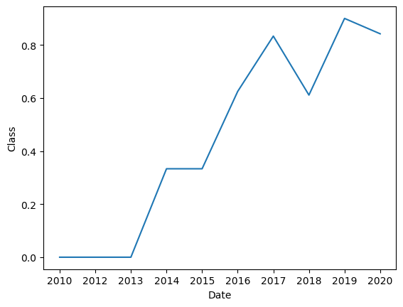
Launch Success Yearly Trend
This plot shows that while there were 0 initial successes before 2014, launch success quickly rose to become more than 80% in 2020. There is also a noticeable downturn in success rate only for 2018.

Slide 23
Launch Site Names
Query: SELECT DISTINCT Launch_Site FROM SPACEXTABLE;
Launch_Site
CCAFS LC-40
VAFB SLC-4E
KSC LC-39A
CCAFS SLC-40
This selects every unique launch site name from the table.

Slide 24
Launch Site Names Beginning With ‘CCA’
Query: SELECT * FROM SPACEXTABLE
WHERE Launch_Site LIKE 'CC%’
LIMIT 5;
Date | Time (UTC) | Booster_Version | Launch_Site | Payload | PAYLOAD_MASS__KG_ | Orbit | Customer | Mission_Outcome | Landing_Outcome
2010-06-04 | 18:45:00 | F9 v1.0 B0003 | CCAFS LC-40 | Dragon Spacecraft Qualification Unit | 0 | LEO | SpaceX | Success | Failure (parachute)
2010-12-08 | 15:43:00 | F9 v1.0 B0004 | CCAFS LC-40 | Dragon demo flight C1, two CubeSats, barrel of Brouere cheese | 0 | LEO (ISS) | NASA (COTS) NRO | Success | Failure (parachute)
2012-05-22 | 7:44:00 | F9 v1.0 B0005 | CCAFS LC-40 | Dragon demo flight C2 | 525 | LEO (ISS) | NASA (COTS) | Success | No attempt
2012-10-08 | 0:35:00 | F9 v1.0 B0006 | CCAFS LC-40 | SpaceX CRS-1 | 500 | LEO (ISS) | NASA (CRS) | Success | No attempt
2013-03-01 | 15:10:00 | F9 v1.0 B0007 | CCAFS LC-40 | SpaceX CRS-2 | 677 | LEO (ISS) | NASA (CRS) | Success | No attempt
This selects 5 sites whose launch site’s name begins with ‘CCA’

Slide 25
Total Payload Mass From NASA
Query: SELECT SUM(PAYLOAD_MASS__KG_)
FROM SPACEXTABLE
WHERE CUSTOMER = 'NASA (CRS)';
SUM(PAYLOAD_MASS__KG_)
45596
This selects the sum of all payload masses from launches by NASA

Slide 26
Average Payload Mass of F9 v1.1 Booster
Query: SELECT AVG(PAYLOAD_MASS__KG_)
FROM SPACEXTABLE
WHERE Booster_Version = 'F9 v1.1';
AVG(PAYLOAD_MASS__KG_)
2928.4
This selects the average mass from every payload carried by the F9 v1.1 Booster.

Slide 27
First Successful Ground Landing Date
Query: SELECT MIN(Date) FROM SPACEXTABLE
WHERE Landing_Outcome = 'Success (drone ship)';
MIN(Date)
2016-04-08
This selects the lowest (earliest) date of a successful ground landing.

Slide 28
Successful Drone Ship Landings With Mass Between 4000-6000 kg
Query: SELECT Booster_Version FROM SPACEXTABLE
WHERE PAYLOAD_MASS__KG_ > 4000
AND PAYLOAD_MASS__KG_ < 6000
AND LANDING_OUTCOME = 'Success (drone ship)';
Booster_Version
F9 FT B1022
F9 FT B1026
F9 FT B1021.2
F9 FT B1031.2
This selects every booster version that has had a successful drone ship landing while carrying a mass between 4000 and 6000 kg.

Slide 29
Total Successful and Failed Missions
Query:
SELECT COUNT(Mission_Outcome) FROM SPACEXTABLE
WHERE Mission_Outcome = 'Success’;
SELECT COUNT(Mission_Outcome) FROM SPACEXTABLE
WHERE Mission_Outcome != 'Success';
COUNT(Mission_Outcome)
98
COUNT(Mission_Outcome)
3
The left output is the total number of successful missions.
The right output is the total number of failed missions.

Slide 30
Boosters Which Carried the Max Payload
Query: SELECT Booster_Version FROM SPACEXTABLE
WHERE PAYLOAD_MASS__KG_ = (SELECT MAX(PAYLOAD_MASS__KG_)
FROM SPACEXTABLE);
Booster_Version
F9 B5 B1048.4
F9 B5 B1049.4
F9 B5 B1051.3
F9 B5 B1056.4
F9 B5 B1048.5
F9 B5 B1051.4
F9 B5 B1049.5
F9 B5 B1060.2
F9 B5 B1058.3
F9 B5 B1051.6
F9 B5 B1060.3
F9 B5 B1049.7
This selects every booster which has carried a payload with mass equal to the maximum.

Slide 31
2015 Launch Records
Query: SELECT substr(Date, 6,2), Landing_Outcome, Booster_Version, Launch_Site FROM SPACEXTABLE
WHERE substr(Date,0,5)='2015’
GROUP BY substr(Date, 6,2);
substr(Date, 6,2) | Landing_Outcome | Booster_Version | Launch_Site
01 | Failure (drone ship) | F9 v1.1 B1012 | CCAFS LC-40
02 | Controlled (ocean) | F9 v1.1 B1013 | CCAFS LC-40
03 | No attempt | F9 v1.1 B1014 | CCAFS LC-40
04 | Failure (drone ship) | F9 v1.1 B1015 | CCAFS LC-40
06 | Precluded (drone ship) | F9 v1.1 B1018 | CCAFS LC-40
12 | Success (ground pad) | F9 FT B1019 | CCAFS LC-40
This counts the number of failures by type in the year 2015.

Slide 32
Ranking Outcomes Between
2010-06-04 and 2017-03-20
Query: SELECT Landing_Outcome, COUNT(Landing_Outcome) FROM SPACEXTABLE
WHERE DATE >= '2010-06-04' AND DATE <= '2017-03-20’
GROUP BY Landing_Outcome
ORDER BY COUNT(Landing_Outcome) DESC;
Landing_Outcome | COUNT(Landing_Outcome)
No attempt | 10
Success (drone ship) | 5
Failure (drone ship) | 5
Success (ground pad) | 3
Controlled (ocean) | 3
Uncontrolled (ocean) | 2
Failure (parachute) | 2
Precluded (drone ship) | 1
This counts the number of landing types, and sorts them by frequency.

Slide 33
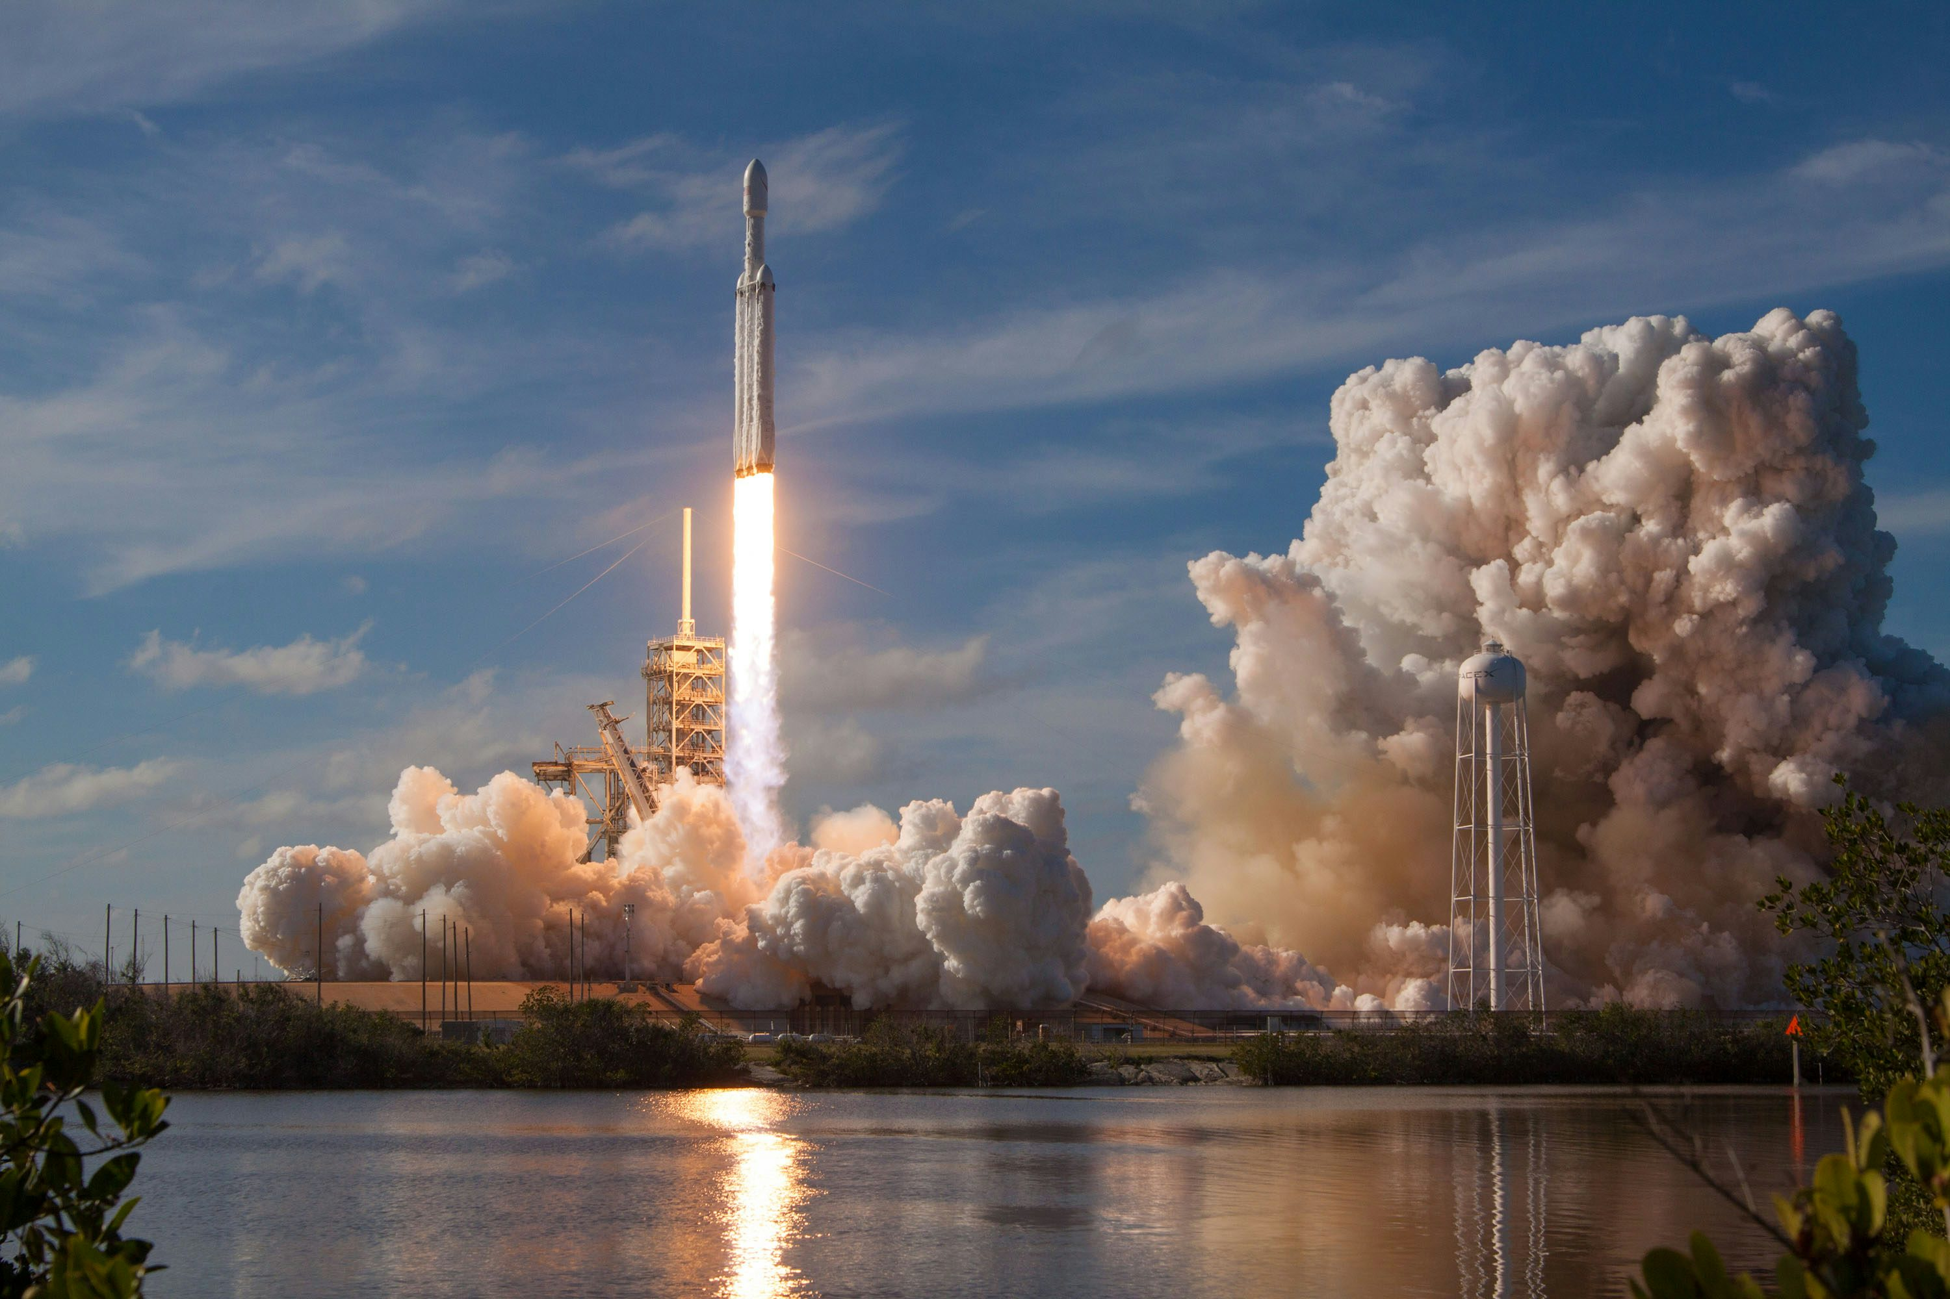
Section 3
Visualizing Geographical Data via Folium

Slide 34
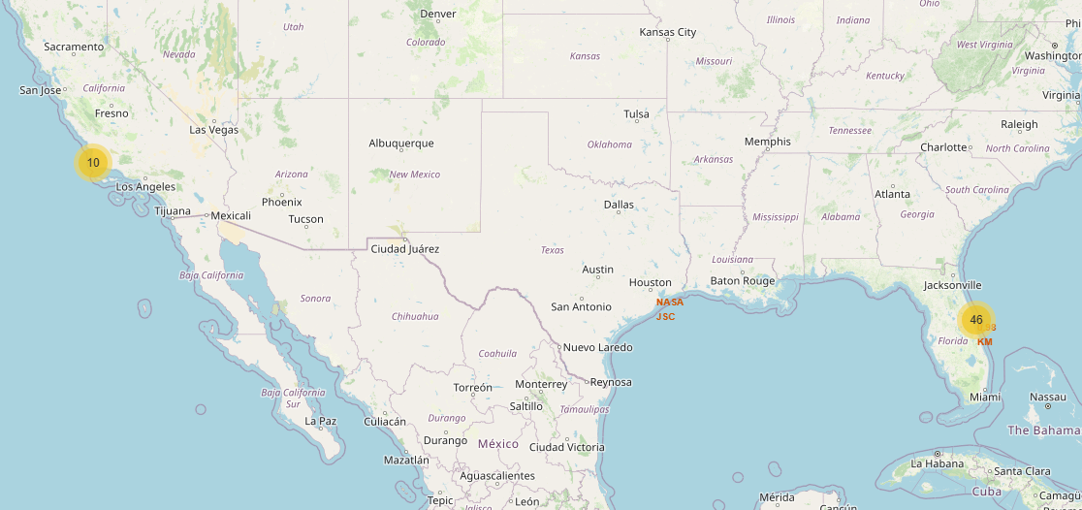
Folium Marker Map
We can tell that there are only two launch locations: one on the west coast and one on the right coast.

Slide 35
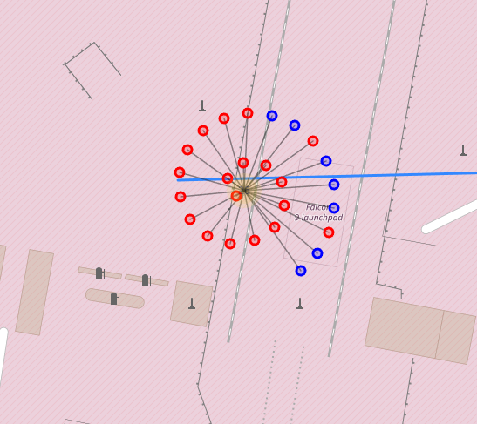
Folium Success/Fail Markers
Here, red points are the failures, and blue points are the successes. The inner points are the oldest, while the outer ones are the most recent; this allows you to see the distribution of successes and fails over time.

Slide 36
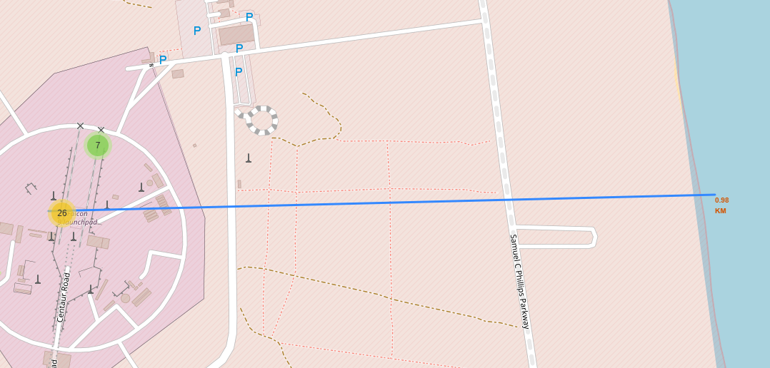
Folium Distance Marker
Here, we can see the distance to the nearest coastline is one kilometer, which is very close. This could be due to the fact that failed landings are more likely to wind up in the ocean.

Slide 37
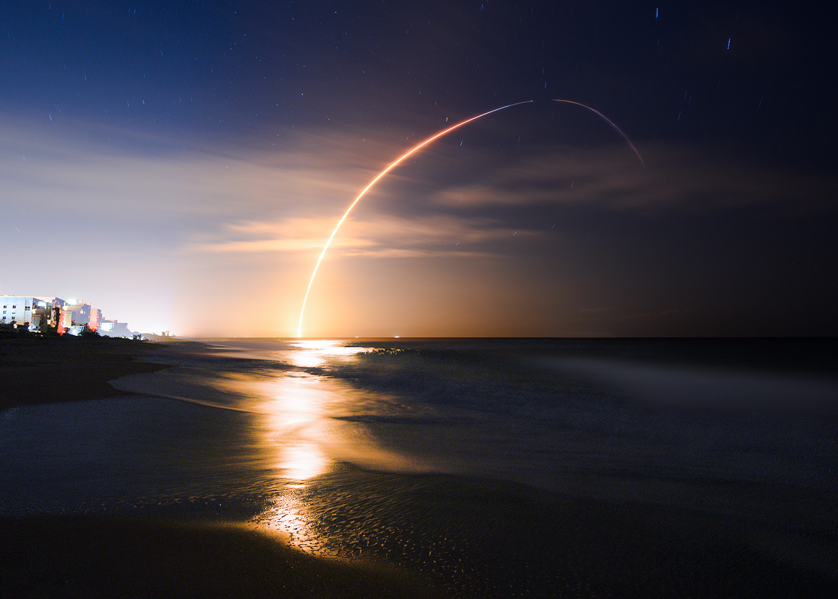
Section 4
Interactive Plots with Plotly Dashboard

Slide 38
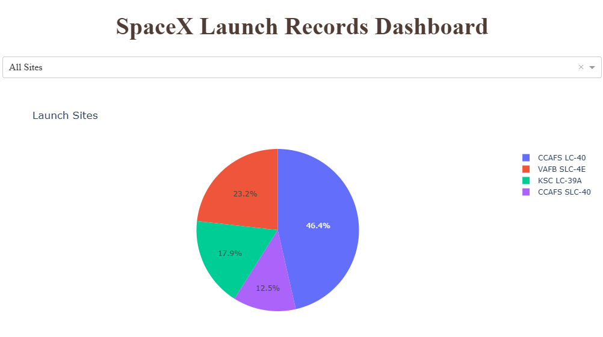
Dashboard Pie Chart of Launch Sites
We can tell that the most common launch site was CCAFS LC-40, followed by VAFB, KSC, and finally CCAFS SLC-40 used the least.

Slide 39
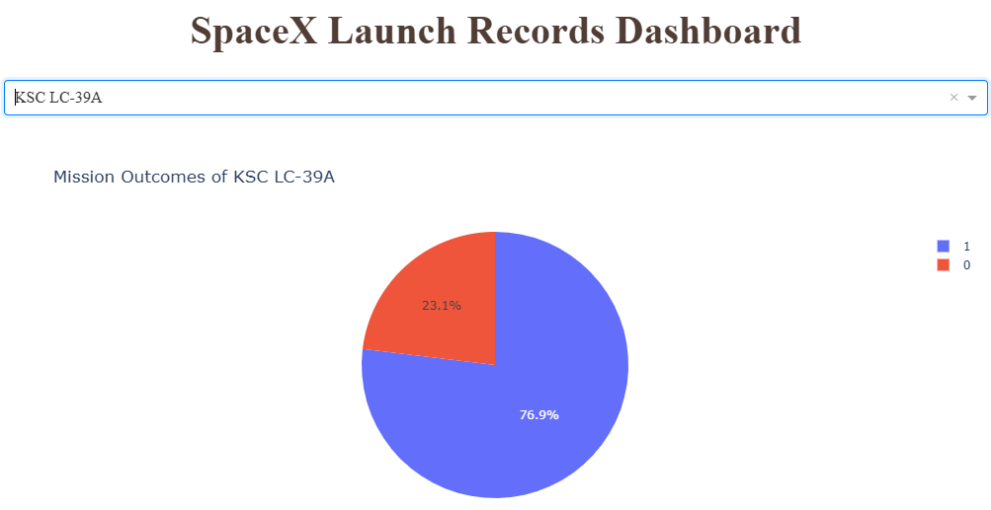
Dashboard Pie Chart of Launch Success
We can tell that the KSC launch site had a success rate of 76.9%, the highest of the launch sites.

Slide 40
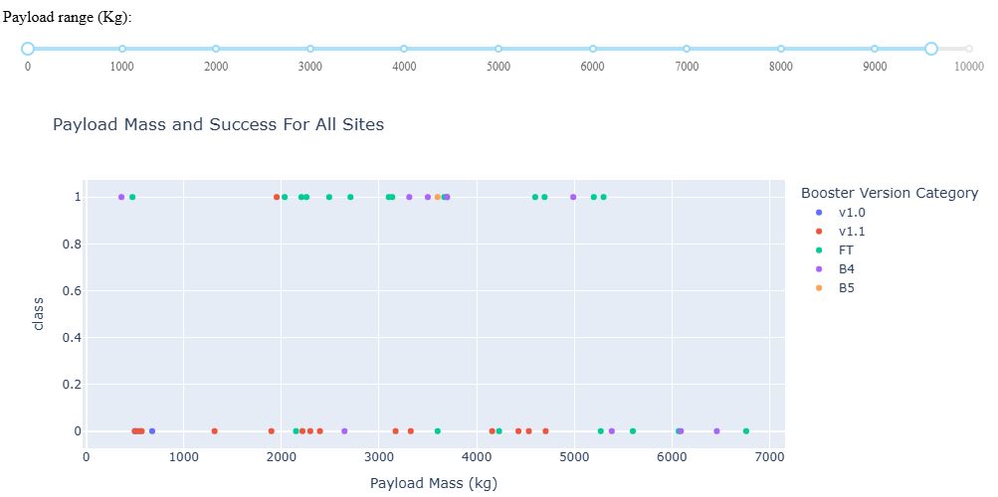
Dashboard Scatter Plot of
Payload vs. Outcome
We can see that most launches were failures, and most successes happened with middle payload weights. The FT booster seems to have the highest success rate.

Slide 41

Section 4
Interactive Plots with Plotly Dashboard

Slide 42
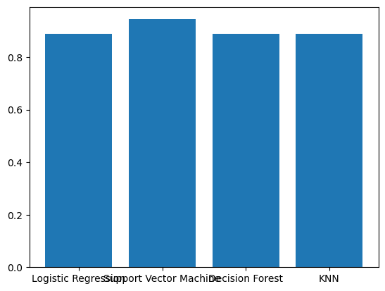
Classification Accuracy
The Support Vector Machines model had the highest accuracy, while the Logistic Regression, Decision Forest, and KNN models had equal lower accuracy.

Slide 43

Confusion Matrix
The Confusion Matrix for the SVM shows that it only misclassified one point, while all of the other models misclassified two.

Slide 44
Conclusions
The rate of success increased over the years.
Booster type, Payload Weight, Launch Date, and Launchpad Location are all relevant to success probability.
Most launches came from the launch pad in Florida, on the east coast.
All payloads were between 400 and 7000 kg.
The most common orbit types were VLEO, GTO, and ISS.

Slide 45
Appendix
Link to the Github main page:
https://github.com/JC18000/IBM-Data-Science-Capstone/tree/main

Slide 46
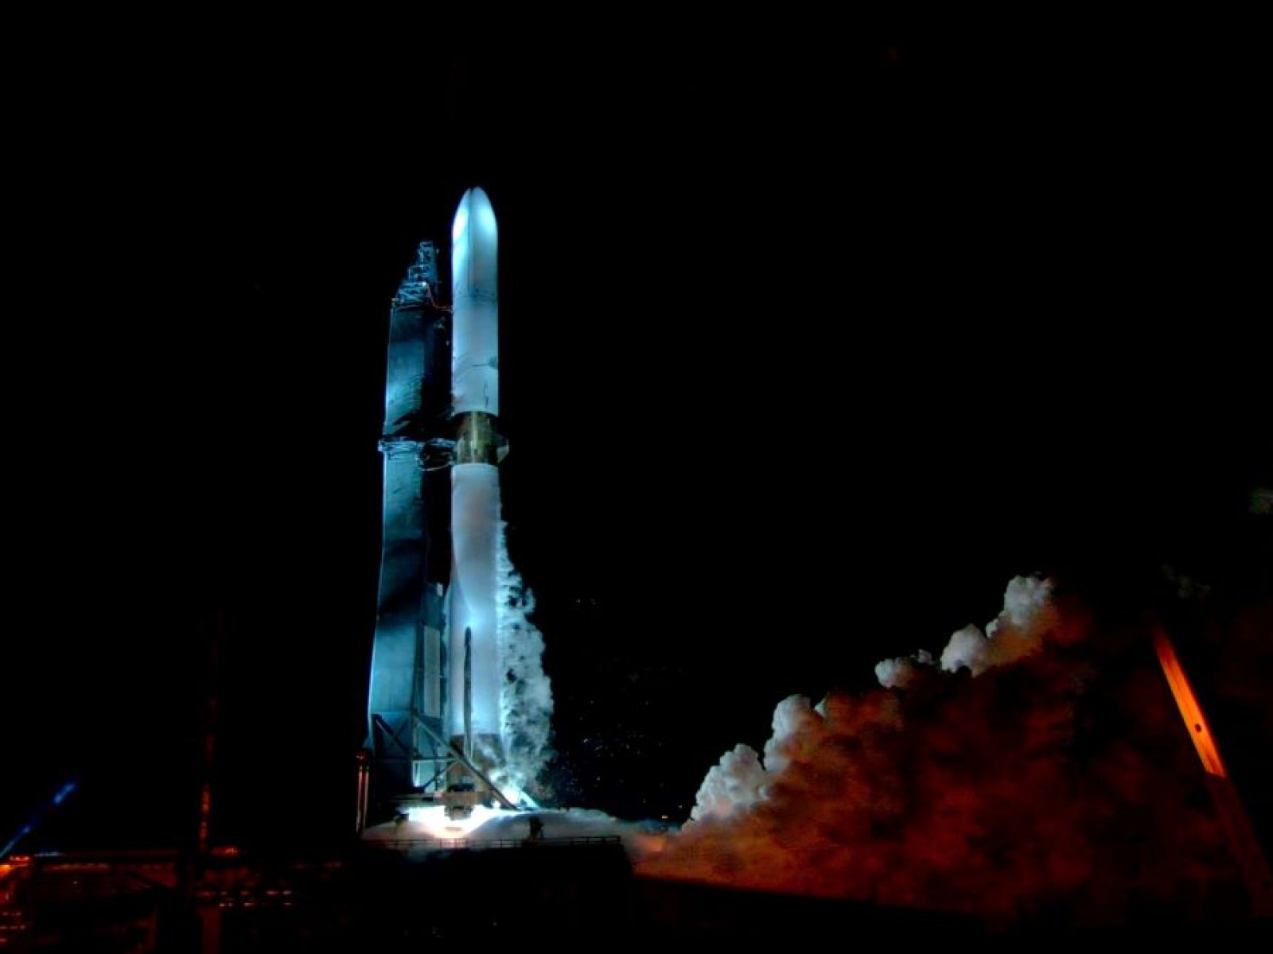
The End
Thanks for following along!

